Slide 1
Course : ARTIFICIAL INTELLIGENCE
UNIT-4
Dr. P Udayakumar,
Professor,
Department of Computer Science & Engineering
Aditya Engineering College(A)
Email: udayakumarp@aec.edu.in
Mobile: 9893263785

Slide 2

KNOWLEDGE REPRESENTATION
Aditya Engineering College (A)
Knowledge representation (KR) is an important issue in both cognitive science and artificial intelligence.
In cognitive science, it is concerned with the way people store and process information and
In artificial intelligence (AI), main focus is to store knowledge so that programs can process it and achieve human intelligence.
There are different ways of representing knowledge e.g.
predicate logic,
semantic networks,
extended semantic net,
frames,
conceptual dependency etc
In predicate logic, knowledge is represented in the form of rules and facts .

Slide 3
Aditya Engineering College (A)
Semantic Network:
Formalism for representing information about objects, people, concepts and specific relationship between them.
The syntax of semantic net is simple. It is a network of labeled nodes and links.
It’s a directed graph with nodes corresponding to concepts, facts, objects etc. and
arcs showing relation or association between two concepts.

Slide 4
Aditya Engineering College (A)
Semantic Network:
The commonly used links in semantic net are of the following types.
isa à subclass of entity (e.g., child hospital is subclass of hospital)
inst à particular instance of a class (e.g., India is an instance of country, Name of person is an inst of a person)
prop à property link (e.g., property of dog is ‘bark’, ‘color’)

Slide 5
Aditya Engineering College (A)
Semantic Network:
Every human, animal and bird is living thing who breathe and eat.
All birds can fly.
All man and woman are humans who have two legs.
Cat is an animal and has a fur.
All animals have skin and can move.
Giraffe is an animal who is tall and has long legs.
Parrot is a bird and is green in color.
John is a man

Slide 6
Semantic Network:
Aditya Engineering College (A)
Every human, animal and bird is living thing who breathe and eat.
∀X [human(X) à living(X)]
∀X [animal(X) à living(X)]
∀X [bird(X) à living(X)]
All birds are animal and can fly.
∀X [bird(X) ∧ canfly(X)]
John is a man
Man(John)

Slide 7
Semantic Network:
Aditya Engineering College (A)
Every man and woman are humans who have two legs.
∀X [man(X) ∧ haslegs(X)]
∀X [woman(X) ∧ haslegs(X)]
∀X [human(X) ∧ has(X, legs)]
Cat is an animal and has a fur.
animal(cat) ∧ has(cat, fur)
All animals have skin and can move.
∀X [animal(X) à has(X, skin) ∧ canmove(X)]

Slide 8
Aditya Engineering College (A)
Semantic Network:
Giraffe is an animal who is tall and has long legs. animal(giraffe) ∧ has(giraffe, long_legs) ∧ is(giraffe, tall)
Parrot is a bird and is green in color. bird(parrot) ∧ Is(parrot, green_colour)

Slide 9
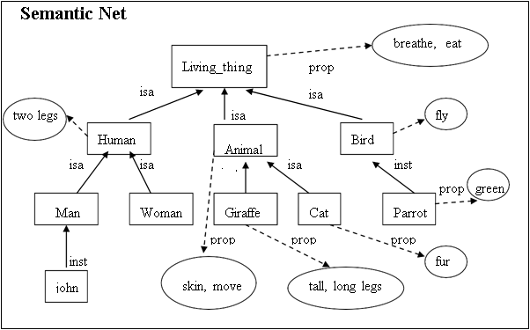
Aditya Engineering College (A)
Representation in Semantic Net

Slide 10
Extended Semantic Network (ESNet)
Aditya Engineering College (A)
In conventional Sem Net, clausal form of logic can not be expressed.
Extended Semantic Network (ESNet) combines the advantages of both logic and semantic network.
In the ESNet, terms are represented by nodes similar to Sem Net.
Binary predicate symbols in clausal logic are represented by labels on arcs of ESNet.
Conclusions and conditions in clausal form are represented by different kinds of arcs.
Conditions are drawn with two lines
and conclusions are drawn with one heavy line

Slide 11
Extended Semantic Network
Aditya Engineering College (A)
Example:
X is Father of Z. Z is Parent of Y. Give the relation of X and Y in ESNet.
Represent ‘grandfather’ definition
Gfather(X, Y) ß Father(X, Z), Parent(Z, Y) in ESNet.
Z
Father
Parent
X
Y
Gfather

Slide 12
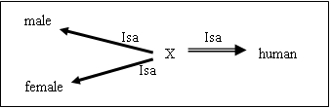
Extended Semantic Network
Aditya Engineering College (A)
Example2:
Represent clausal rule “Male(X), Female(X) ß Human(X)” using binary representation as
“Isa(X, male), Isa(X, female) ß Isa( X, human)”
and subsequently in ESNet as follows:

Slide 13
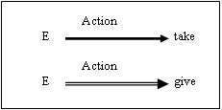
Extended Semantic Network
Aditya Engineering College (A)
Inference Rules
Inference rules are embedded in the representation itself.
The inference that “for every action of giving, there is an action of taking” in clausal logic written as
“Action(E, take) ß Action(E, give)”.
The inference rule such as “an actor of taking action is also the recipient of the action” can be easily represented in clausal logic as:
Here E is a variable representing an event where an action of taking is happening).

Slide 14
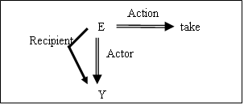
Extended Semantic Network
Aditya Engineering College (A)
Inference Rules
Recipient(E, Y) ß Acton(E, take), Actor (E, Y)

Slide 15
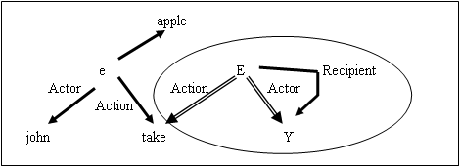
Extended Semantic Network
Aditya Engineering College (A)
Example2:
Represent the following clauses of Logic in ESNet.
Action(e, take).
Recipient(E, Y) ß Acton(E, take), Actor (E, Y)
Object (e, apple).
Actor (e, john) .

Slide 16
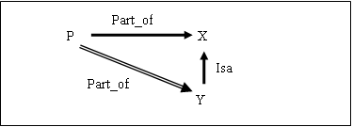
Extended Semantic Network
Aditya Engineering College (A)
Contradiction
The contradiction in the ESNet arises if we have the following situation.

Slide 17
Extended Semantic Network
Aditya Engineering College (A)
Deduction in ES Net
Both of the following inference mechanisms are available in ESNet.
Forward reasoning inference (uses bottom up approach)
Bottom Up Inferencing: Given an ESNet, apply the following reduction (resolution) using modus ponen rule of logic ({A ß B, B} then A).
Backward reasoning inference (uses top down approach).
Top Down Inferencing: Prove a conclusion from a given ESNet by adding the denial of the conclusion to the network and show that the resulting set of clauses in the network is inconsistent

Slide 18
Extended Semantic Network
Aditya Engineering College (A)
Deduction in ES Net
Example: Bottom Up Inferencing

Slide 19
Extended Semantic Network
Aditya Engineering College (A)
Deduction in ES Net
Example: Top down Inferencing

Slide 20
Extended Semantic Network
Aditya Engineering College (A)
Contradiction
The contradiction in the ESNet arises if we have the following situation.
Part_of
P
X
Isa
Part_of
Y

Slide 21
Knowledge Representation using Frames
Aditya Engineering College (A)
Frames are more structured form of packaging knowledge,
used for representing objects, concepts etc.
Frames are organized into hierarchies or network of frames.
Lower level frames can inherit information from upper level frames in network.
Nodes are connected using links viz.,
ako / subc (links two class frames, one of which is subclass of other e.g., science_faculty class is ako of faculty class),
is_a / inst ( connects a particular instance of a class frame e.g., Renuka is_a science_faculty
a_part_of (connects two class frames one of which is contained in other e.g., faculty class is_part_of department class).

Slide 22
Knowledge Representation using Frames
Aditya Engineering College (A)
.
Property link of semantic net is replaced by SLOT fields
A frame may have any number of slots needed for describing object.
e.g.,
faculty frame may have name, age, address, qualification etc as slot names.

Slide 23
Knowledge Representation using Frames
Aditya Engineering College (A)
Each frame includes two basic elements : slots and facets.
Each slot may contain one or more facets (called fillers) which may take many forms such as:
value (value of the slot),
default (default value of the slot),
range (indicates the range of integer or enumerated values, a slot can have),
demons (procedural attachments such as if_needed, if_deleted, if_added etc.) and
other (may contain rules, other frames, semantic net or any type of other information).

Slide 24
Knowledge Representation using Frames
Aditya Engineering College (A)
Description of Frames
Each frame represent either a class or an instance.
Class frame represents a general concept whereas instance frame represents a specific occurrence of the class instance.
Class frame generally have default values which can be redefined at lower levels.
If class frame has actual value facet then decedent frames can not modify that value.
Value remains unchanged for subclasses and instances.

Slide 25
Knowledge Representation using Frames
Aditya Engineering College (A)
Frame Network – Example

Slide 26
Knowledge Representation using Frames
Aditya Engineering College (A)
Example of a Book
Slots | Filters
Title | Artificial Intelligence
Genre | Computer Science
Author | Peter Norvig
Edition | Third Edition
Year | 1996
Page | 1152

Slide 27
Knowledge Representation using Frames
Aditya Engineering College (A)
Frame Network – Example

Slide 28
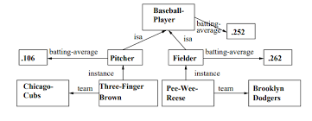
Knowledge Representation using Frames
Aditya Engineering College (A)

Slide 29
Knowledge Representation using Frames
Aditya Engineering College (A)
Frame Network – Inheritance in Frames
Suppose we want to know nationality or phone of an instance-frame frame13 of renuka.
These information are not given in this frame.
Search will start from frame13 in upward direction till we get our answer or have reached root frame.
The frames can be easily represented in prolog by choosing predicate name as frame with two arguments.
First argument is the name of the frame and second argument is a list of slot - facet pair.

Slide 30
Knowledge Representation using Frames
Aditya Engineering College (A)
Advantages of frame representation:
The frame knowledge representation makes the programming easier by grouping the related data.
The frame representation is comparably flexible and used by many applications in AI.
It is very easy to add slots for new attribute and relations.
It is easy to include default data and to search for missing values.
Frame representation is easy to understand and visualize.

Slide 31
Knowledge Representation using Frames
Aditya Engineering College (A)
Disadvantages of frame representation:
In frame system inference mechanism is not be easily processed.
Inference mechanism cannot be smoothly proceeded by frame representation.
Frame representation has a much generalized approach.

